Slide 1
Section Assignments
Project Overview - Sloan
Geometry and cooling - Sloan
Stresses and Factor of Safety - Ellen
Injector Design and Ignitor - Wyatt
Testing and Logistics and Electronics - Jeremiah
Failure and Risks - Sloan
References/Closeout - Sloan

Slide 2
Regenerative
Engine PDR
Design Review, October 17, 2026
Notes:
Jasmine

Slide 3
Agenda
Overview 2
Requirements 5
Geometry & Cooling Design 8
Thermal Analysis 13
Stresses & FOS 19
Injector & Plumbing 31
Feed System & Manufacturing 34
Peripherals 38
Testing & Logistics 42
Failures & Risks 48
Notes:
Jasmine

Slide 4
Project Overview
Regeneratively cooled N2O / ethanol engine, 300 lbf at sea level
Fuel cools the chamber before injection (no film cooling, no ablatives, no single use components)
Chamber printed as one piece in AlSi10Mg with integral cooling channels
Goals: validate the thermal model, demonstrate repeated hot fires, and gather data
With characterized engine, future engines can be built to support higher performance, flight vehicles, and other projects

Slide 5
Design Point
Chamber pressure 200 psi, overall O/F 2.00
Thrust 300 lbf sea level, delivered Isp 158 s
Total flow 0.861 kg/s: 0.574 oxidizer, 0.287 fuel
Running fuel rich trades 28 s of Isp for a flame 1,200 K cooler, along with more coolant
Lower Pc reduces heat flux at cost of performance
Case | O/F | Flame temp | Delivered Isp
Design | 2.00 | 1,894 K | 157.8 s
Peak Isp | 4.80 | 3,096 K | 186.0 s

Slide 6
Requirements Flowdown
300 lbf sea level thrust drives throat area and total mass flow
Cooling keeps the hot wall temperature safe for AlSi10Mg (Strength falls sharply after 300 °C)
Bluegrass integration caps supply pressures: fuel 700 psi max, oxidizer self pressurized
LPBF manufacturability sets a 1.0 mm floor on any printed geometry

Slide 7
Requirements & Verification (1/2)
# | Requirement | Rationale | Verification
1 | Produce 300 lbf ±10% at sea level | Matches program goal, sizes stand load path | Test: Load cell during hot fire
2 | Operate at Pc 200 psi ±10% | Sets throat size and all thermal loads | Test: Chamber pressure transducer during hot fire
3 | Peak hot wall below 300 °C for ≥ 10 s | AlSi10Mg strength falls sharply above 300 °C | Test + analysis: Coolant and barrel temp during hot fire testing, analyze data
4 | Bulk coolant subcooled at jacket outlet | Bulk boiling starves fuel flow and drives an O/F excursion | Test + analysis: Coolant temp and pressure during hot fire, analyze data
5 | Jacket holds 700 psi with chamber at 0 psi, FoS ≥ 1.5 | Worst case during fuel lead and cold flow | Test: Hydrostatic

Slide 8
Requirements & Verification (2/2)
# | Requirement | Rationale | Verification
6 | No leaks at any seal at operating pressure | A leak across the ox/fuel boundary mixes propellants | Test: Hydrostatic and cold flow
7 | All features printable at 1.0 mm minimum | Vendor process limit | Inspection: Sectioned sample
8 | Jacket ΔP within the fuel supply budget | Fuel regulated to 700 psi maximum | Test: Cold flow with jacket inlet and outlet PTs
9 | Integrates with Bluegrass mounts and plumbing | Test site compatibility | Inspection: Integration checked, demonstration in cold flow

Slide 9
End of Overview
Questions?

Slide 10
Geometry & Cooling
Presented by Sloan Robbins

Slide 11
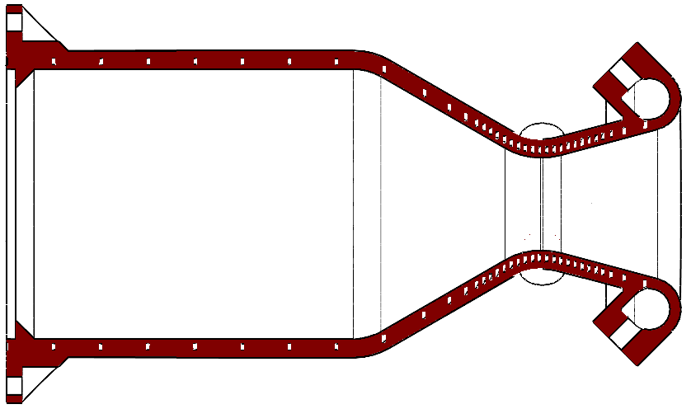
Chamber Geometry
Chamber 89.0 mm (3.50 in) inner diameter
Outer diameter 100 mm
Throat 31.0 mm, exit 49.5 mm
Expansion ratio 2.56 from optimum expansion: Pc / Pa = 200 / 14.7
L* 1.2 m
Contraction ratio 8.25, convergent 30°, divergent 15°
Sized for sea level expansion using CEA outputs and MatLab script with standard NASA rocket equations

Slide 12
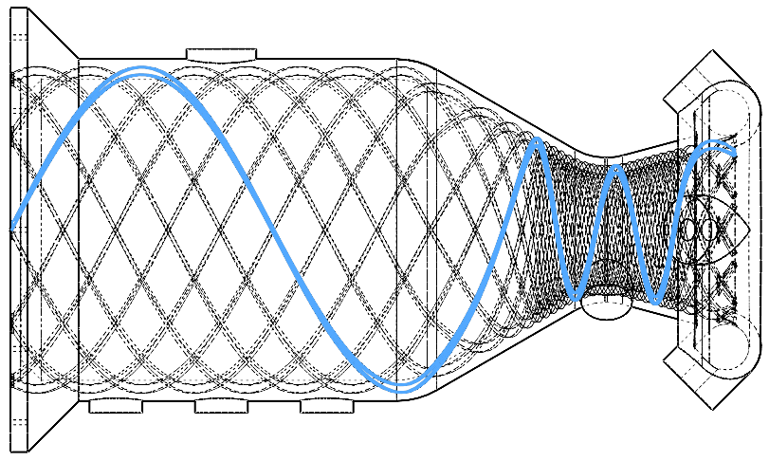
Cooling Channels
10 helical starts, constant 1.0 mm wide × 2.5 mm deep
Hot wall 1.0 mm, land 1.0 mm at the throat, opening to 12 mm in the barrel to minimize path length (pressure drop)
Helix angle is set by the land which is based on flux and coolant temp, effective channel density

Slide 13
Channel Count and Size
Lower limit of geometry is set at 1.0mm by manufacturing method
Three channel variables yield two properties: width, depth, count -> ΔP, velocity
Any increase in any variable decreases both pressure drop and velocity, therefore cooling
Any decrease in any variable therefore increases performance, at the cost of higher feed pressures
10 × 1.0 × 2.5 is a balance of cooling performance with a “reasonable” pressure drop (~300psi)
Supply pressure only acts as a lever for bulk coolant subcooling and has no impact on actual cooling performance.

Slide 14
Helical vs. Axial
Land width fixes channel count
Axial channels at the throat force about 49 starts, which means slower coolant and worse cooling
The helix shrinks perpendicular pitch by cos θ, a ~5× gain in effective channel density
Deep channels add sidewall without adding gas side footprint, which means the benefits of a larger channel without the downsides of a wide channel
Cost is path length, nearly triple the axial, paid in feed pressure
  Takeaway: Helical channels act to maximize channel density independent of actual channel size
θ

Slide 15
Thermal Model
Looped in MatLab from coolant inlet to injector, for entire length of engine.
Gas side: Bartz with sigma correction, NASA CEA gas properties
Coolant side: Gnielinski for Nusselt with Sieder-Tate viscosity correction, Haaland to calculate Darcy-Weisbach friction factor for roughness (assumed Ra of 6µm from vendor specs, converted to sand grain using standard industry model of ε = 4 * Ra, which is conservative)
Lands treated as straight fins in heat transfer
Solved for steady state heat transfer for cold wall and hot wall
Hot Wall Flux -> Bulk Coolant Temp -> Cold Wall Temp -> Hot Wall Temp

Slide 16


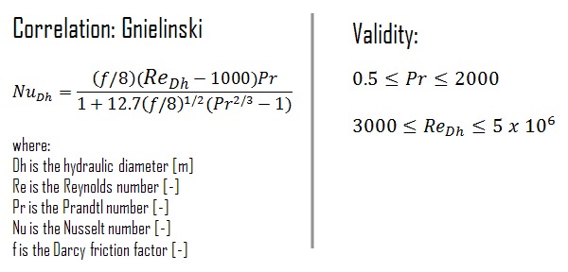
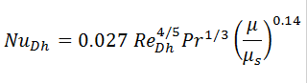
Thermal Model Equations
Convective Heat Transfer Coefficient for Internal Fluid Flow
Haaland Equation for Darcy-Weisbach Friction
Sieder-Tate Correlation for Nusselt (Viscosity Correction)
Gnielinski Correlation for Nusselt

Slide 17
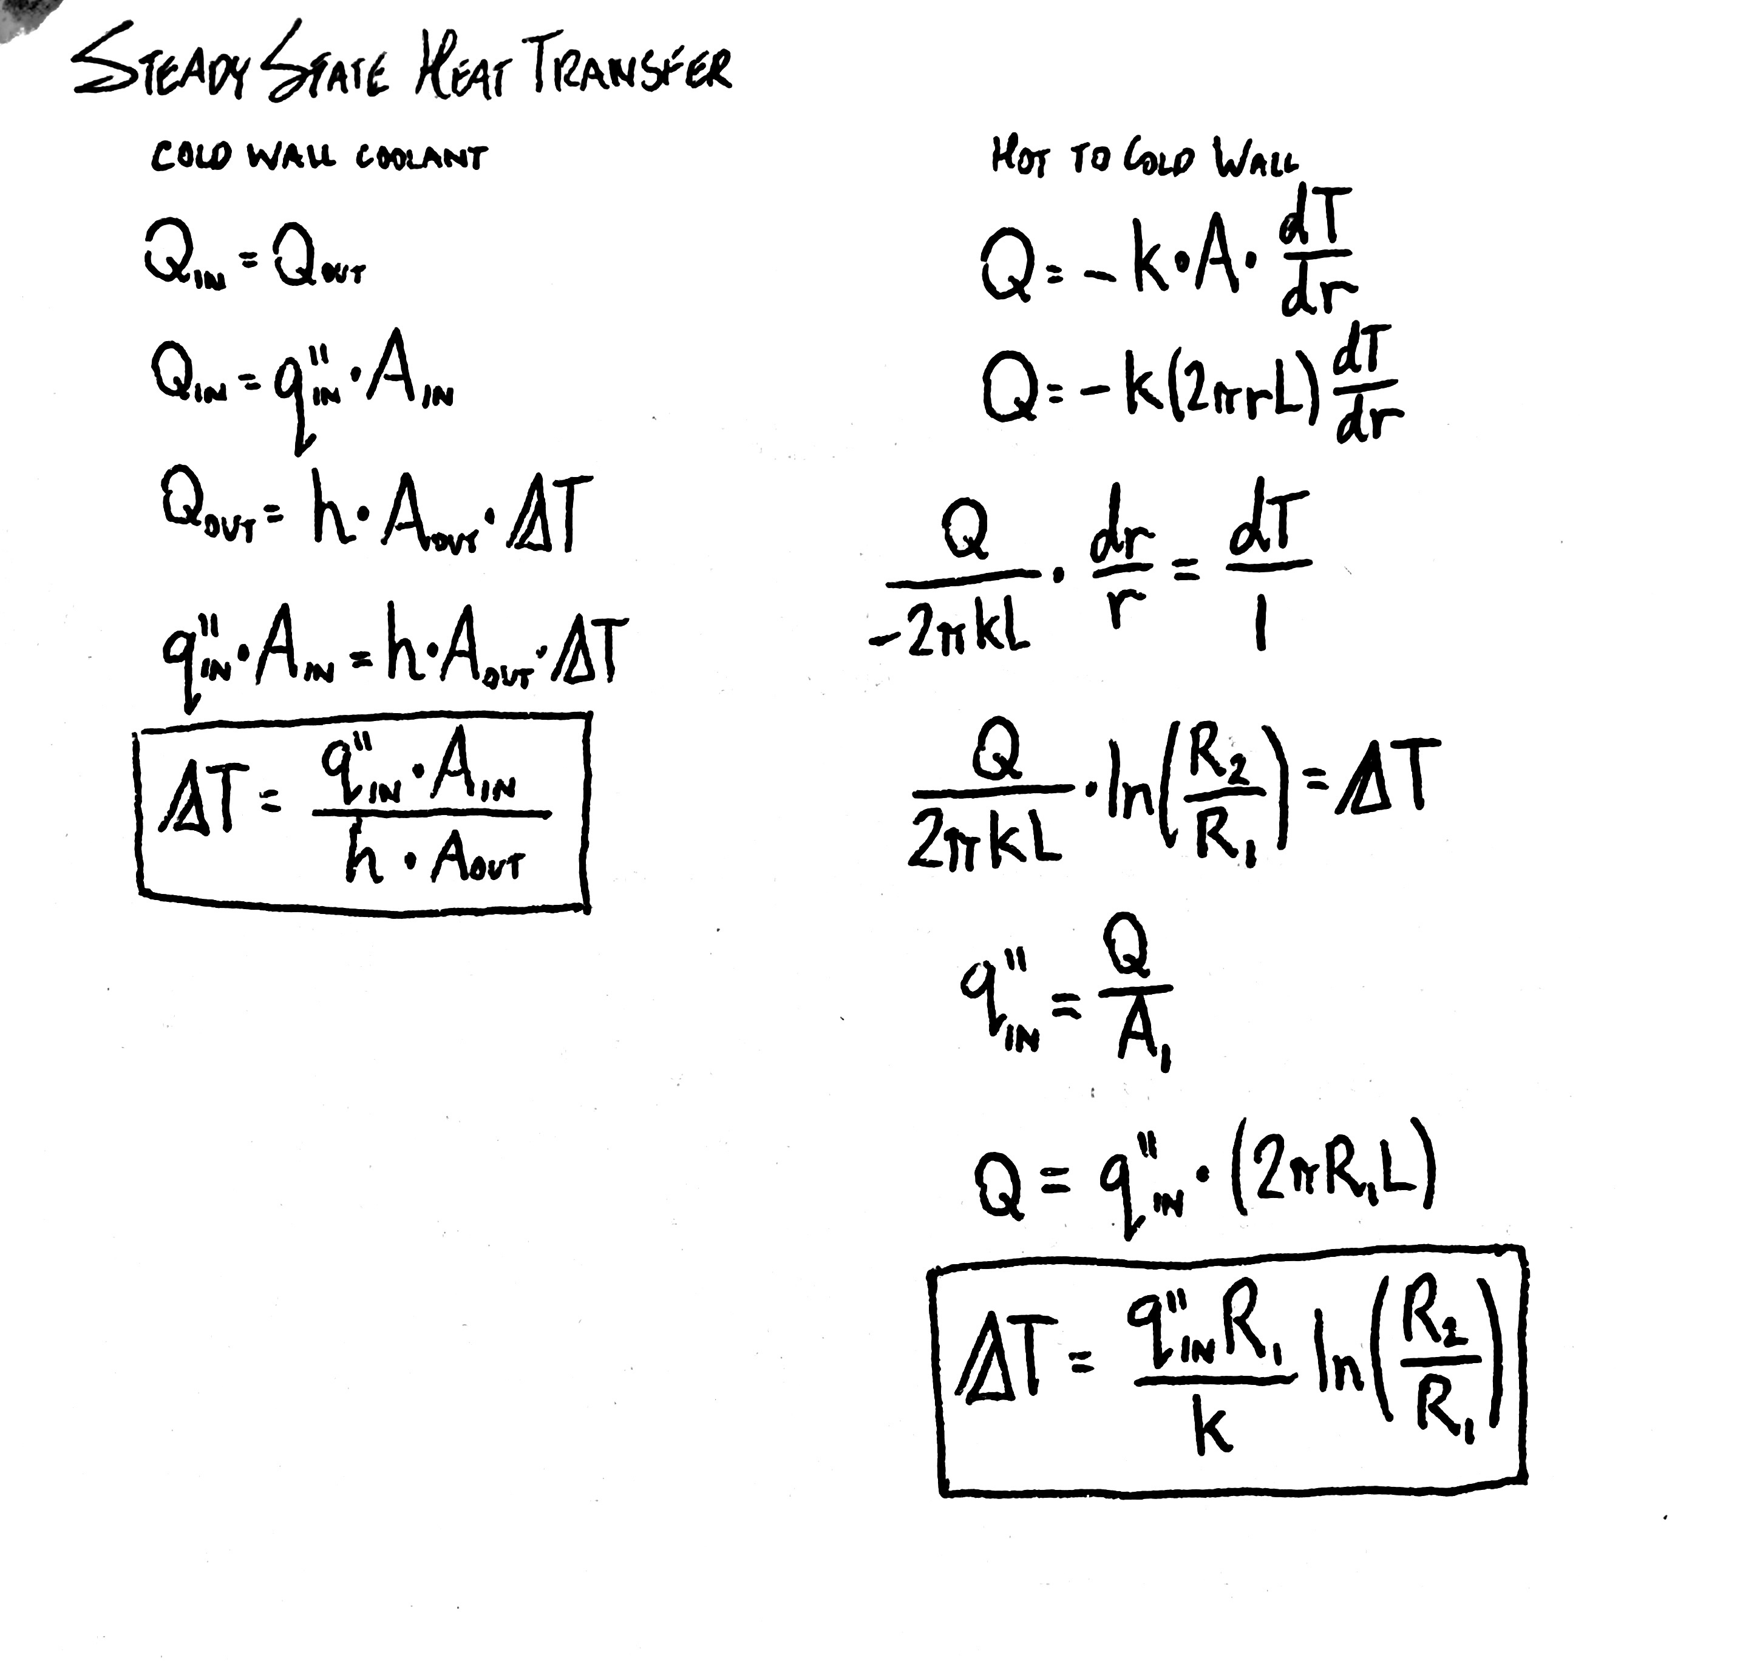
Steady State Heat Transfer
Derived relationships between coolant temperature versus cold wall and cold wall versus hot wall

Slide 18
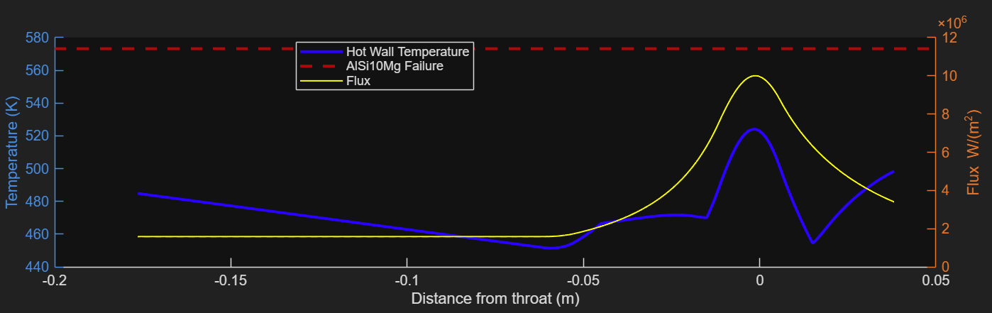
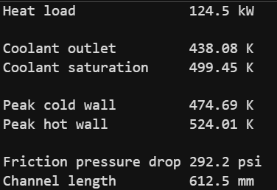
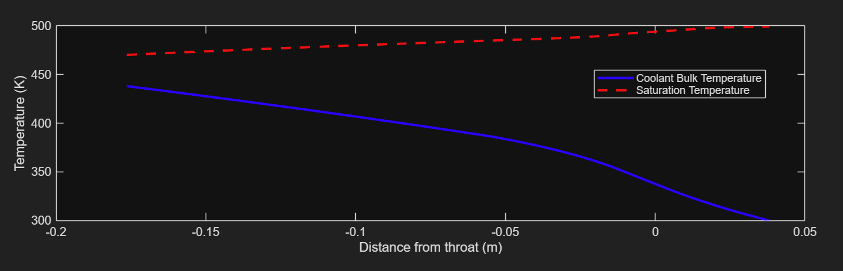
Thermal Results
Takeaways:
Bulk coolant is ~60K subcooled
Hot wall is ~50K below “failure” temperature
Pressure drop <300psi

Slide 19
Optimism vs. Pessimism
Optimistic: reality likely better | Pessimistic: reality could be worse
Bartz calculated at 1.0, small engines typically measure 0.6–0.8, which drastically drops flux [Smith; Lv et al.] | Without polishing inner bore, hot gas heat transfer will increase beyond what Bartz predicts for hydraulically smooth walls
Combustion assumed complete at the injector face, so barrel load is overstated | Injector streaks of oxidizer could put lean, hot mixture at the wall locally
No credit taken for wall thermal mass | Recirculation at the face to wall corner can raise local flux
Rougher than assumed channels cool better | Smoother channels cool worse

Slide 20
End of Geometry & Cooling
Questions?

Slide 21
Stresses & FOS
Presented by Ellen Poulsen

Slide 22
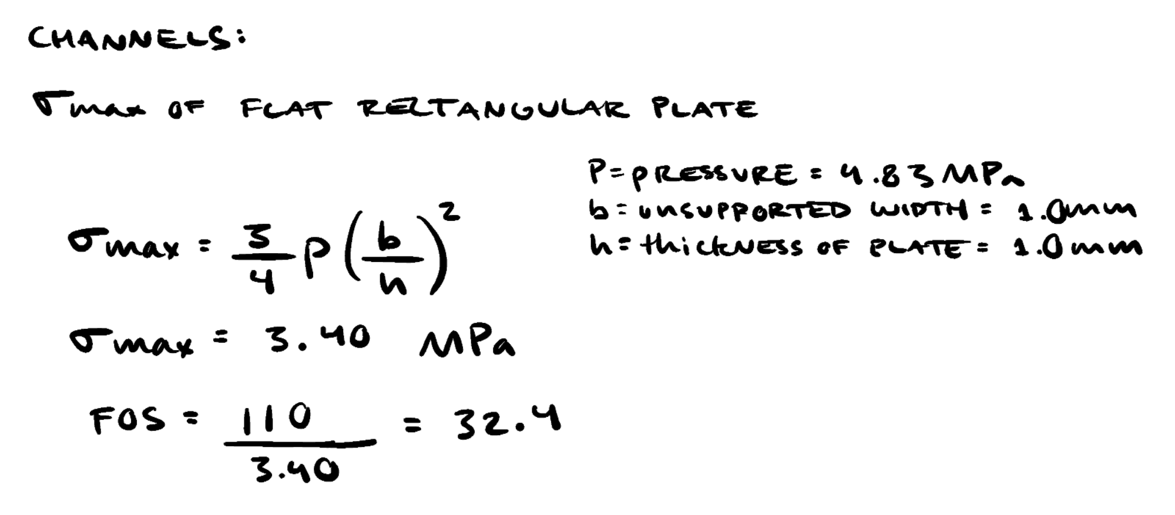
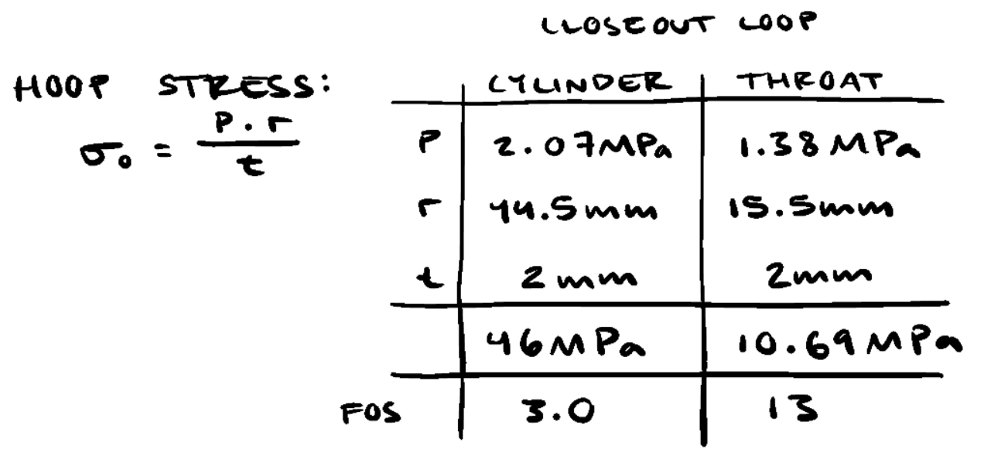
Channel Stress and Hoop Stress
Thermal stress is more significant concern than mechanical stress, check worst case mechanical stress during fuel leads and cold flows (700psi in jacket, chamber at 0psi). Use hot yield temp for conservative calcs.
Pressure stresses are small because each channel spans only 1.0 mm
Location | Stress | Allowable | FoS
Wall bending over 1.0 mm channel due to pressure | 3.4 Mpa | 110 MPa at 250 °C | 32.4
Closeout hoop, barrel | 46 MPa | 140 MPa at 150 °C | 3.0
Closeout hoop, throat | 10.69 MPa | 140 MPa at 150 °C | 13

Slide 23
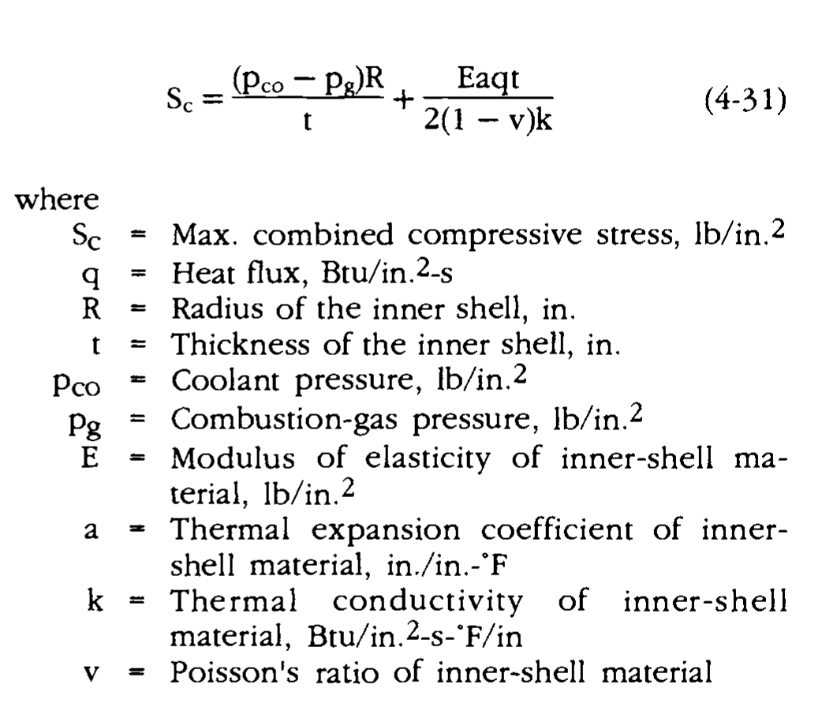
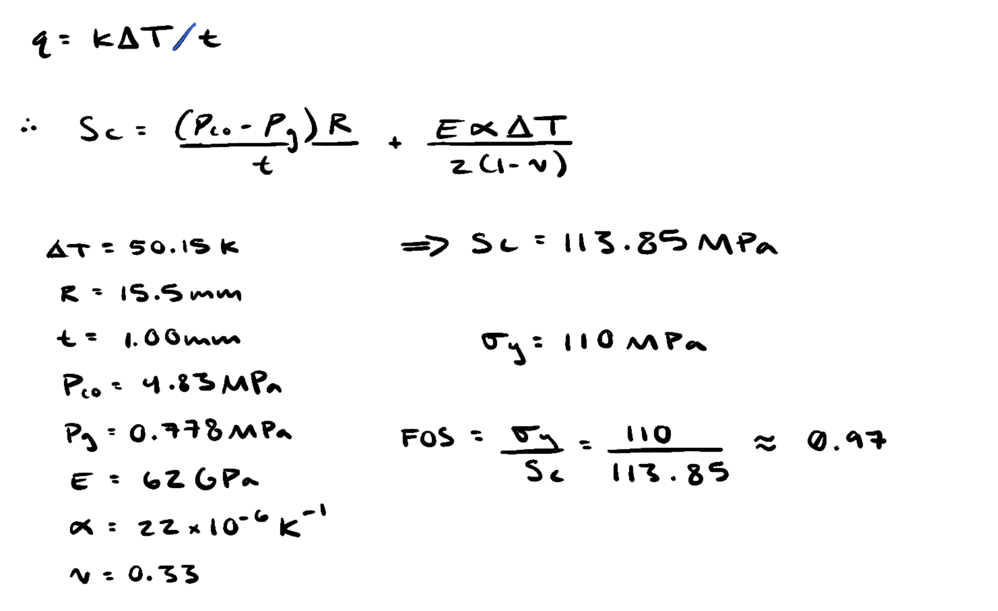
Thermal Stress
*Substitute with Fourier's Law of One-Dimensional Heat Conduction (use delta T = T_hotwall – T_coldwall
At maximum stress conditions and at 1mm wall thickness, FOS < 1
Local yielding alone does not prove immediate elastic failure, should be paired with consideration of cycle fatigue determine how plastic deformation stabilizes and effects material over time
"The maximum stress occurs at the
inner-wall surface of the inner shell and can be
calculated from this equation" (Huzel and Huang).

Slide 24

Life Cycle Fatigue
Low Cycle Fatigue is a common point of failure from regenerative engines
Complex analysis exists but often require datasets or more complex material properties from testing (such as exponents in Morrow Design Rule, only plastic deformation considered in Coffin Manson equation, elastic only in Basquin's equation).
The Manson Universal Slopes Equation is a version of the Morrow Design rule with unknown exponents set as an average across metals.
Example of Morrow Design Rule (elastic + plastic)
Notes:
https://ntrs.nasa.gov/api/citations/19670030324/downloads/19670030324.pdf?utm_%E2%80%8B
Mechanical property improvements of LPBF-AlSi10Mg via forging to modify microstructure and defect ch…

Slide 25
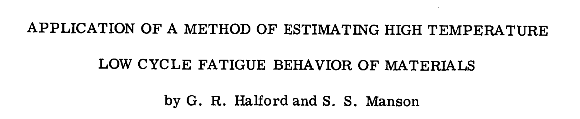
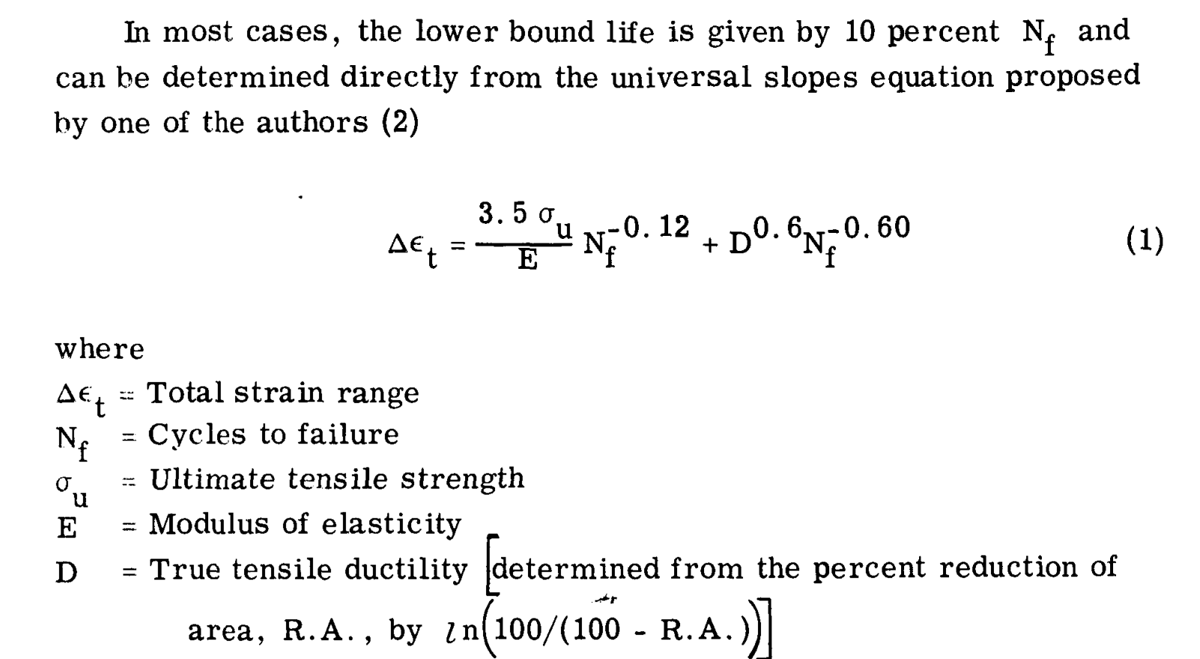
Life Cycle Fatigue
Manson & Halford Research: how to accurately estimate high temperature low cycle fatigue, and application of linear damage analysis of fatigue and stress rupture
10% rule: life lower bound for thermal applications can be safely approximated as 10% of cycles found for non-thermal applications (accounting for thermal and creep)
Therefore, given our low overall number of tests (and lower number of hot fires) results indicating a high FOS for cyclical loading can be used among other considerations to help validate safety of engine.
Notes:
https://ntrs.nasa.gov/api/citations/19670030324/downloads/19670030324.pdf?utm_%E2%80%8B

Slide 26
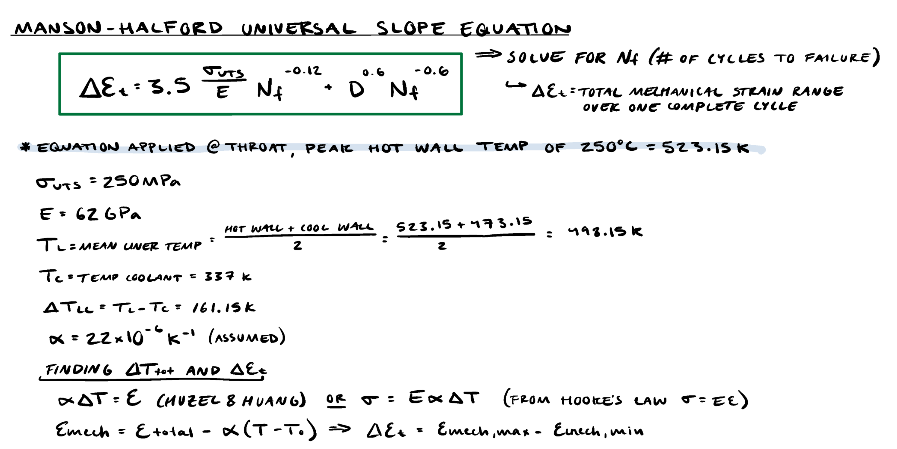
Life Cycle Fatigue Calcs
Calculated at throat, where thermal stress will be the greatest. Uses material properties at peak hot wall temp.
Notes:
https://ntrs.nasa.gov/api/citations/19670030324/downloads/19670030324.pdf?utm_%E2%80%8B

Slide 27
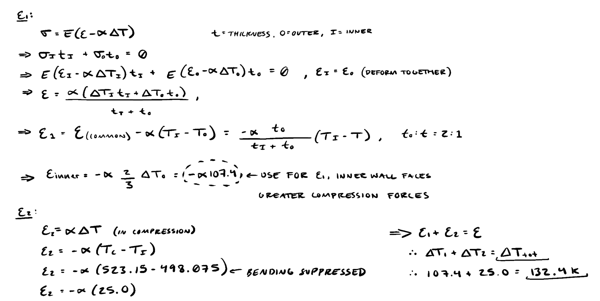
Life Cycle Fatigue Calcs
Hot wall wants to expand but is limited by wall around it. With temperature gradient across, hot wall is forced into compression.
Break thermal strain into two parts:
ε₁ (inner layer vs. outer layer): assume bonded layers see strain together (balancing forces). Use temperature value for inner wall, sees greater strain in compression, therefore uses compressed value.
ε₂ (hot face vs. mean inner temperature):
523.15 K − 498.15 K = 25 K, with bending ignored.
Notes:
https://ntrs.nasa.gov/api/citations/19670030324/downloads/19670030324.pdf?utm_%E2%80%8B

Slide 28
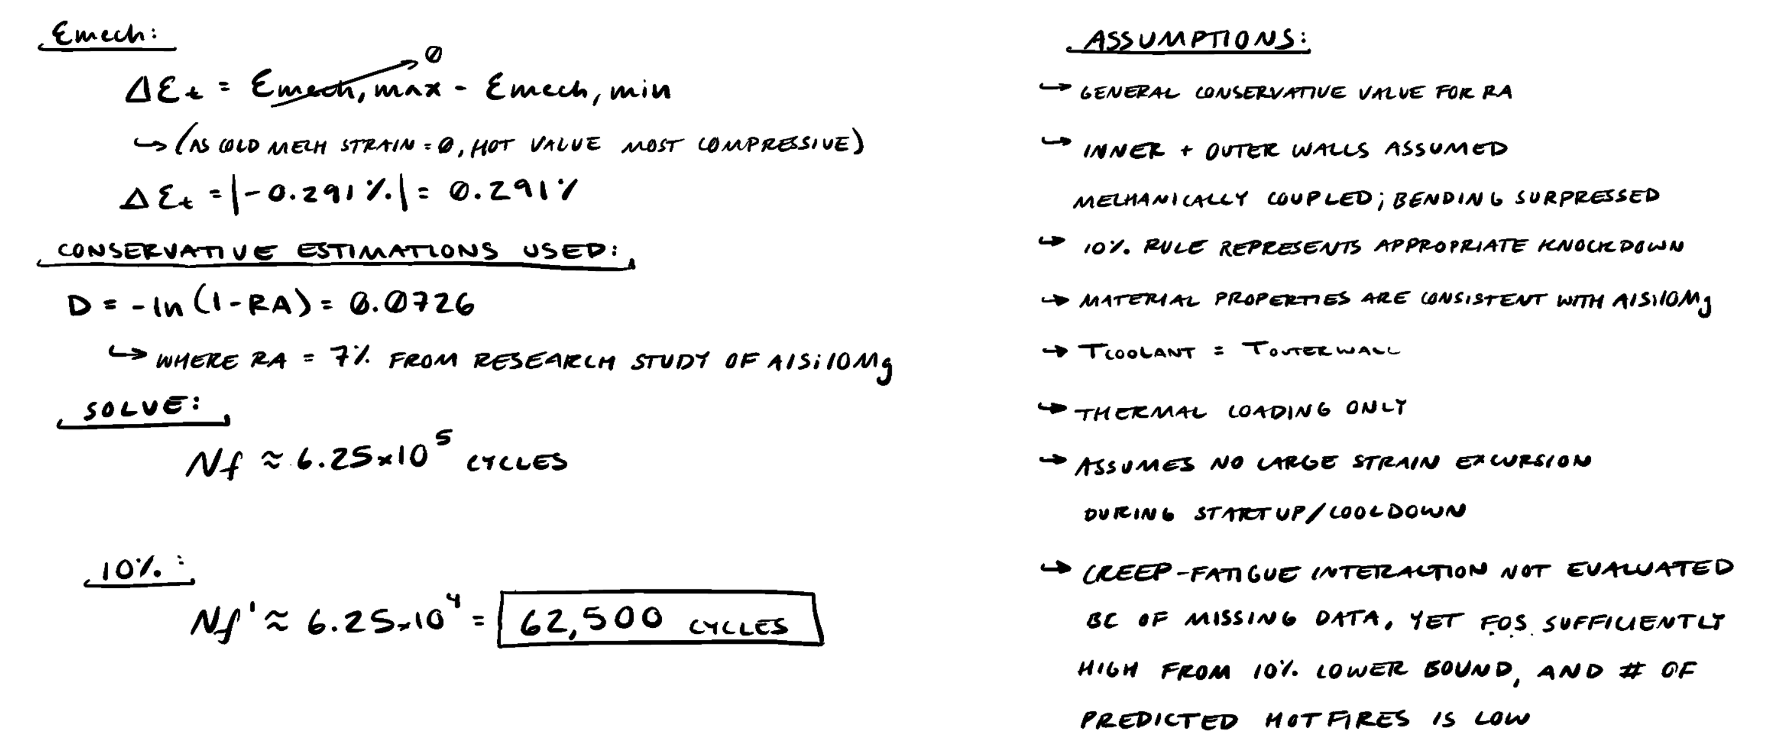

Life Cycle Fatigue Calcs
Strain range:
The wall starts cold at zero mechanical strain, and the hot condition is the most compressive.
The range is the magnitude of that swing, 0.291%.
Solve: The equation gives Nf ≈ 6.25×10⁵ cycles. 10% rule: Following Halford & Manson, the lower-bound life is 10% of that, so 62,500 cycles.
Notes:
https://ntrs.nasa.gov/api/citations/19670030324/downloads/19670030324.pdf?utm_%E2%80%8B

Slide 29
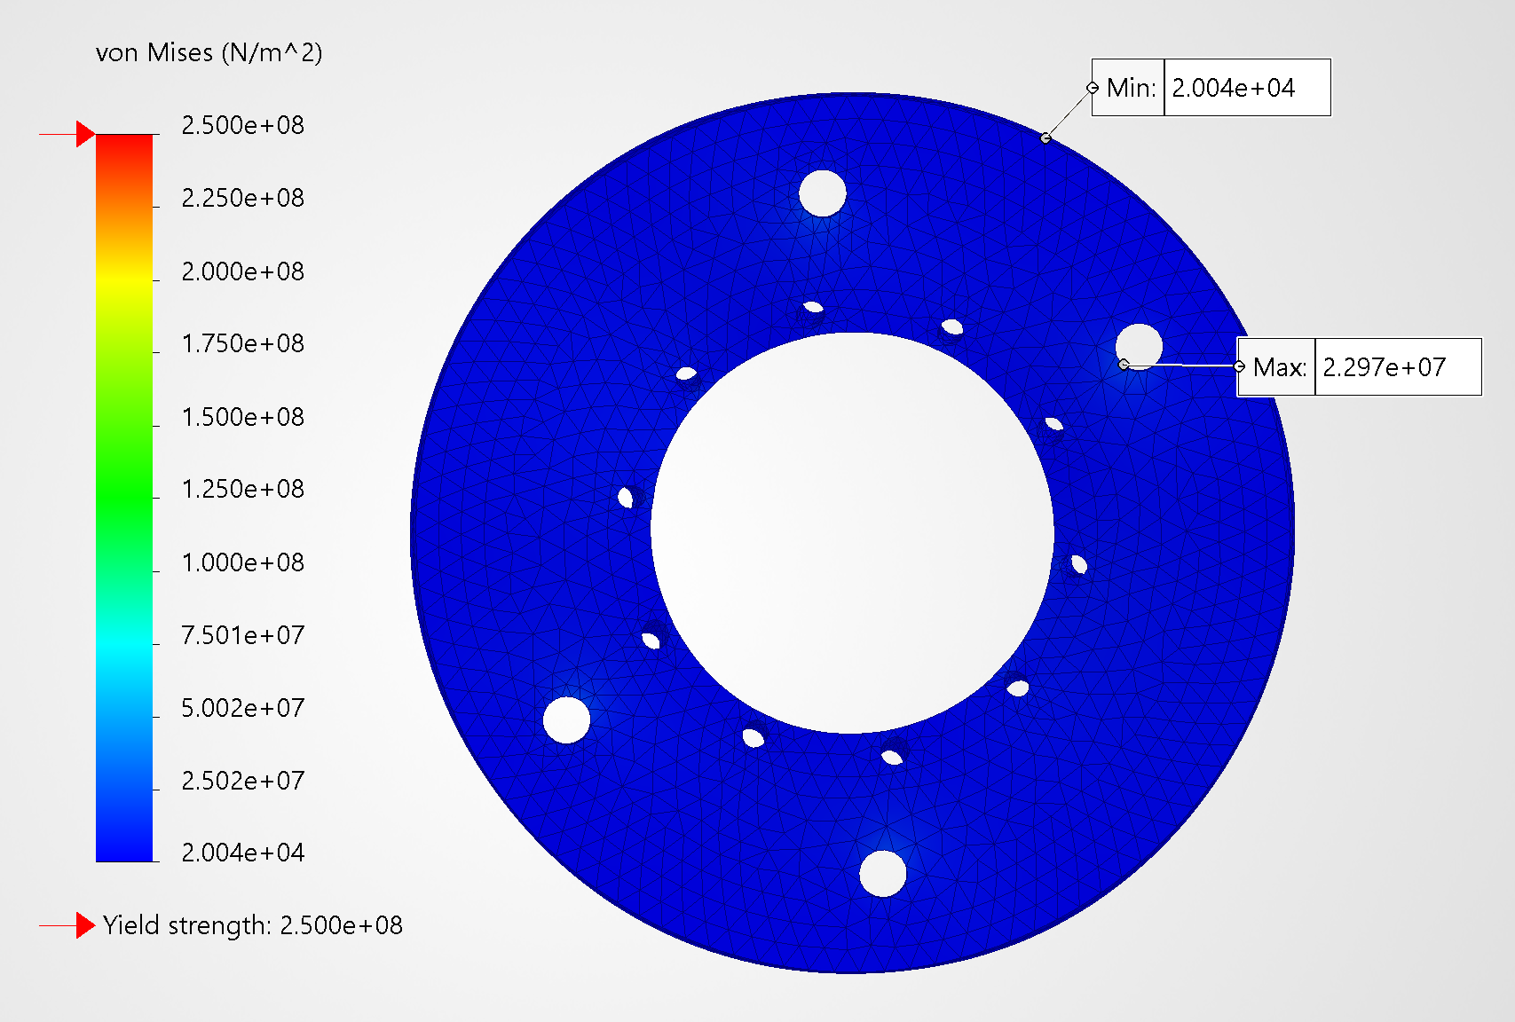
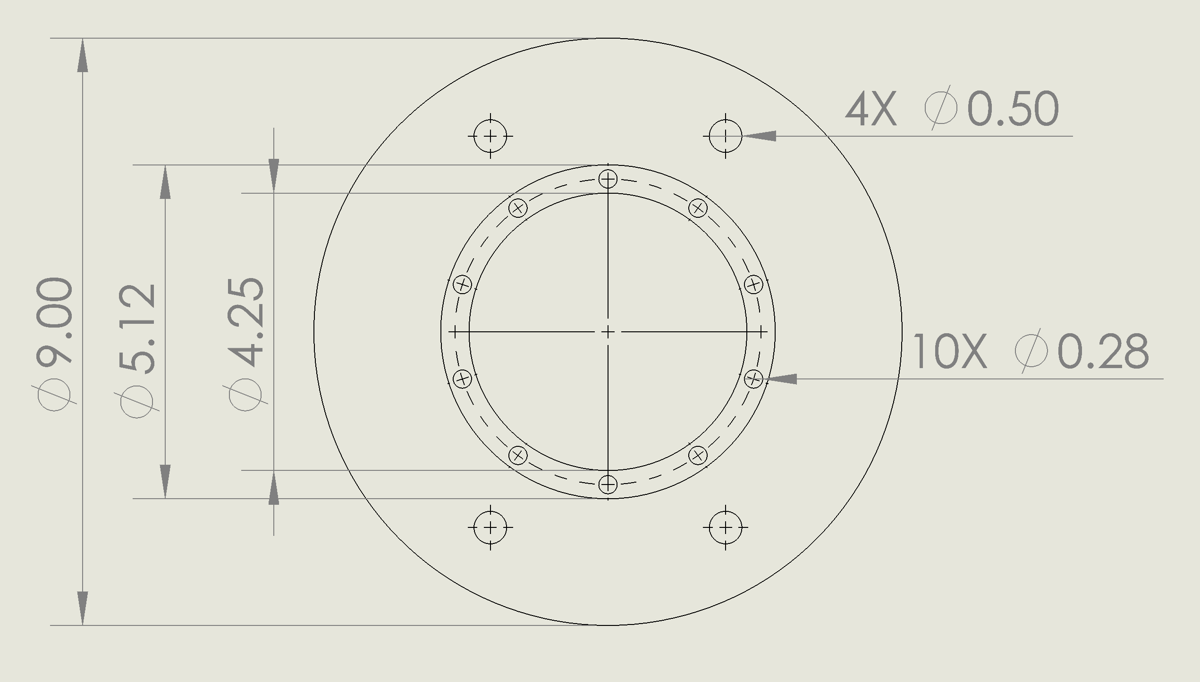
Integration Plate
A36 Steel, 3/8"
Holes for 10 ¼"-20 bolts
Integration for Bluegrass test stand
With 300lbf / 1334.47N applied on inner radius (where engine contacts plate), there is a FOS > 10

Slide 30
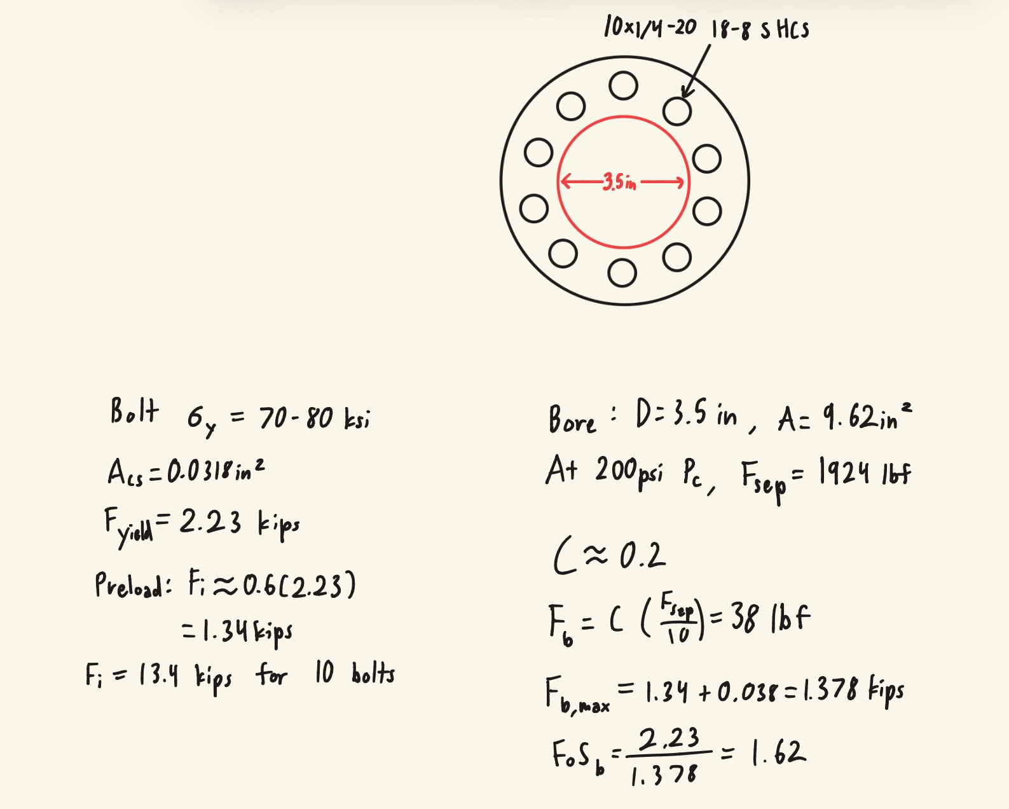
Bolted Joint
10x 1/4-20 stainless bolts with hex nuts, through bolted
Per bolt yield: 2,230 lbf
With 60% preload, conservative bolt FoS of 1.62

Slide 31
End of Stresses & FOS
Questions?

Slide 32
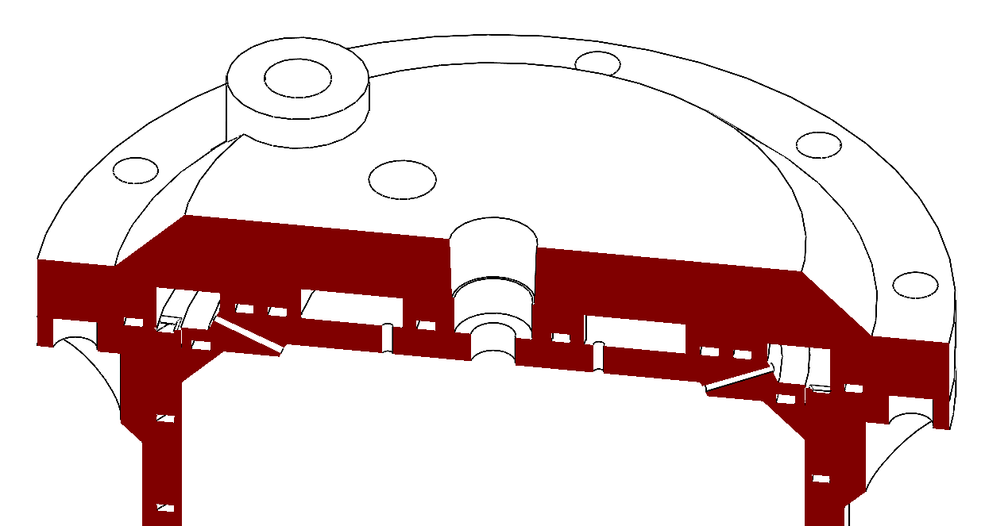
Injector & Plumbing
Presented by Wyatt Matthews

Slide 33
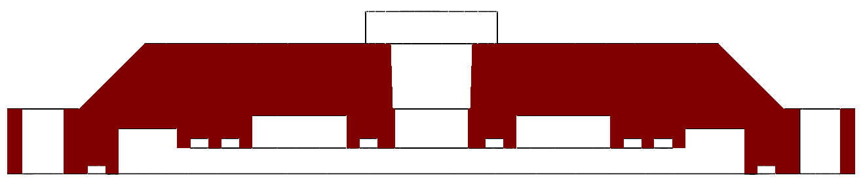
Sealing and O-rings
AFLAS (TFE/P): copolymer O-ring compatible with ethanol and N2O, rated up to 204 °C against ~160 °C at the fuel outlet
.07 in O-rings
Face seals: 0.051 in x .106 in gland sizing gives 27% squeeze, 71% fill
Double O-rings between ox/fuel and single O-rings between ignitor/ox and fuel/exterior

Slide 34
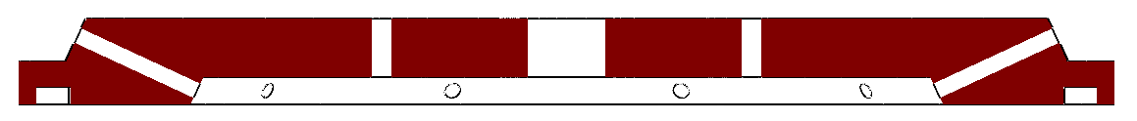
Injector Configuration
10 element pairs: 10 oxidizer orifices at 1.60 mm, 10 fuel orifices at 1.30 mm
Fuel canted 65° into axial oxidizer, impinging ~8 mm off the face (about 5 ox diameters)
J = ρ_ox v_ox² / ρ_f v_f², the ratio of the two jets' momentum flux
At J ≈ 12 the oxidizer jet dominates, so it shears and atomizes the fuel rather than colliding head on
  (verified by cold flow)
Machined in two pieces, so the plate can be re-drilled after cold flow or easily switched out for different designs

Slide 35

N2O Two-Phase Flow
N2O orifice sizing calculated using Dyer two phase model
Feed at 600 psi gives 400 psi across the ox injector, 200% of Pc
Oxidizer orifices checked in cold flow with carbon dioxide to verify behavior
Dyer Two-Phase Model:
$$\dot{m_{NHNE}}=\left(1−\frac{1}{1+κ}\right)\dot{m_{SPI}}+\frac{1}{1+κ}\dot{m_{HEM}}$$

Slide 36
Injector Manufacturing
Carbide drills at the exact design sizes
Carbide stays straight at L/D ≈ 10, HSS prone to wandering
Each canted hole is spot faced normal to its axis, so the drill starts true
Chamfered orifice inlets raise discharge coefficient
Chamfered channel entries in the printed jacket cut entrance loss
CNC available for top and bottom injector plate
  Fuel orifices will be drilled

Slide 37
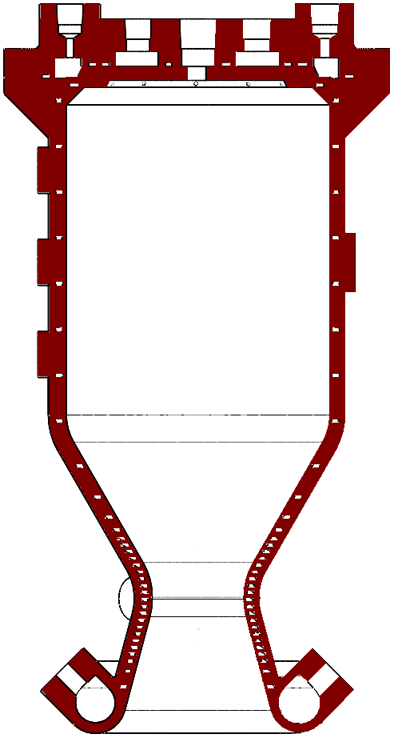
Feed System and Integration
Oxidizer self-pressurized; injector feed assumed at 600 psi
Fuel nitrogen regulated up to 700 psi
Fuel enters at the nozzle end, leaves the jacket at the injector
Budget: 200 psi Pc + 200 psi injector + 300 psi jacket = 700 psi, regulator set point fixed in cold flow
Oxidizer enters the injector top
Fuel stays inside the jacket and injector fuel manifold
Both fuel and oxidizer use 2 × 1/8 NPT inlets to support uniform flow
Adaptors will be manufactured to convert 1/4 NPT to 2 × 1/8 NPT

Slide 38
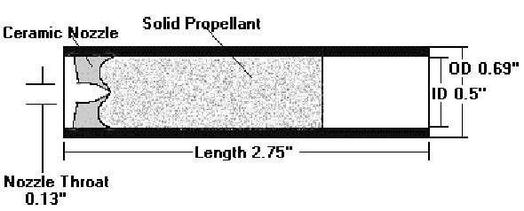
Ignitor
Estes C6-0 engine fitted into a 1/4in NPT socket
Nichrome wire ignition
Burns for 1.6-1.9s
Historically reliable design, used on all other CPSS rocket engines

Slide 39
End of Injector & Plumbing
Questions?

Slide 40
Peripherals
Presented by Jeremiah

Slide 41
Instrumentation
Pressure: Pc, fuel jacket inlet and outlet (jacket ΔP directly), both supplies
Thrust: Load cells
Coolant inlet/outlet thermocouples: Gives total heat load, which calibrates Bartz directly
Three thermocouples: the model predicts a linear wall gradient there, and three points separate linear from curved
Blind holes into lands, wall temperature extrapolated from hole depth
Remaining 2 thermocouples on throat to extrapolate peak wall temp at worst station
TC
Pt
TC

Slide 42
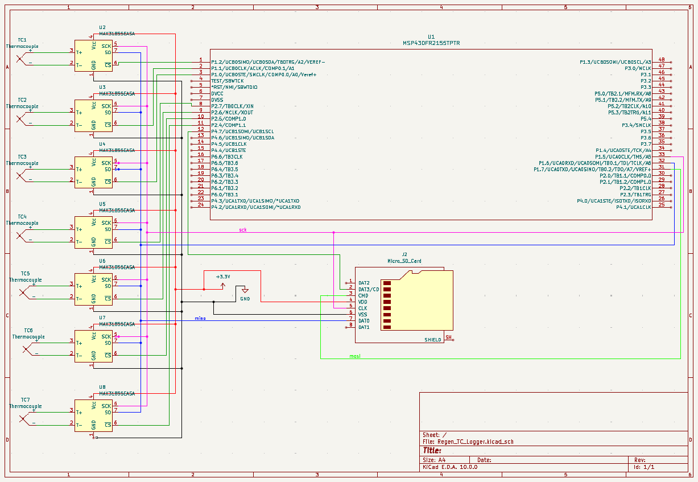
TC Amplifier/Logger
Save money by designing TC data acquisition system (~5x cheaper)
7 TCs, each connected to a MAX6675 amplifier
Data logged to a micro-SD card
Processing handled by TI MSP430 using SPI
Using TI to get experience with the hardware

Slide 43
End of Peripherals
Questions?

Slide 44
Testing & Logistics
Presented by Jeremiah

Slide 45
Test Plan
Test | Goal | Duration | Success criteria
Cold flow 1: Injector + Ignitor | Ox vs. ignitor timing | Sequence | Verified timing and oxidizer flow
Hydrostatic | Verification | 60 s | Jacket holds pressure and no leaks
Cold flow 2: Injector + Chamber | Jacket ΔP, roughness and regulator pressure | 10 s steady | ΔP within budget and fuel flow
Cold flow 3: Chamber | Uniform channel flow + Cd | 10 s steady | Verified channel discharge uniformity
Cold flow 4: Injector + Chamber | Ox vs. fuel timing | Sequence | Fuel lead confirmed
Cold flow 5: Injector + Chamber + Ignitor | Verification | 5 s steady | Uniform flow and correct sequencing
Hot fire 1 | Ignition and short burn | 2–3 s | Wall and coolant at steady state, readings near model
Hot fires 2+ | Duration ladder | 5 → 10 → 20 s | Peak wall < 300 °C, coolant subcooled

Slide 46
Additive Manufacturing
LPBF AlSi10Mg - CuCrZr equivalent quoted near $10k
1.0 mm minimum feature on wall, land and channel width
Printed right side up, all surfaces sit >45° from horizontal and self support, only channel ceilings overhang
Channels left as printed, since roughness helps cooling, throat bore polished
Sample ordered to check channel dimensions, land fusion and preliminary roughness

Slide 47
Bill of Materials (1/2)
Item | Qty | Total | Justification
K-type thermocouple, TC-K6 (Auberins) | 6 | $57.30 | Wall temperature in barrel lands and near the throat band
TC-K-1/8NPT probe (DwyerOmega) | 2 | $204.68 | Coolant inlet and outlet temperature, gives total heat load
6061 disc, 5-1/4 in | 2 | $89.18 | Injector body stock, one spare
6061 disc, 3-5/8 in | 3 | $44.07 | Oxidizer plate stock, spares for other designs/remanufacture
Aflas O-rings, -045/-042/-040/-037/-017 | 12 | $89.71 | Ethanol and N2O compatible, rated 200 °C+
1/4-20 18-8 SHCS and hex nuts | 1 pack | $49.45 | Injector to chamber integration
Thermal paste | 1 | $14.99 | Thermocouple contact in blind holes
Carbide drills | 4 | $68.72 | Orifices at exact design size
Engine print, AlSi10Mg | 1 | $800.00 | Sponsored by UnionFab
Total |  | $618.10

Slide 48
Bill of Materials (2/2)
Item | Qty | Total | Justification
MSP430FR2355 Launchpad | 1 | $15.72 | Read TC data and log to SD card
MAX6675 Amplifier | 7 | $83.3 | Amplify TC signals
SD breakout board | 1 | $3.50 | Integration
Total (electronics) |  | $102.52
Total |  | $720.62

Slide 49
End of Testing & Logistics
Questions?

Slide 50
Failures & Risks
Presented by Sloan

Slide 51
Failure Modes
Mode | Mechanism | Detection | Mitigation
Bulk coolant boiling | Heat load above coolant capacity | Outlet P drop, Pc drop | Supply pressure regulation up to 700 psi
Channel blockage | Powder left in a channel | Cold flow ΔP | Flow test print
Hot wall ratcheting | Cyclic thermal strain | Visual ridges between lands | Inspect between fires
Ox/fuel seal leak | O-ring failure | Cold flow testing | Double O-rings on every ox/fuel boundary

Slide 52
Open Risks
Bulk coolant margin
Injector face thermal load not analyzed
Channel roughness and blockage unmeasured until cold flow
Throat bore roughness

Slide 53
End of Failures & Risks
Questions?

Slide 54
References
Huzel & Huang, Modern Engineering for Design of Liquid-Propellant Rocket Engines
Sutton & Biblarz, Rocket Propulsion Elements
Bartz, A Simple Equation for Rapid Estimation of Rocket Nozzle Convective Heat Transfer Coefficients, 1957
Smith, A Comparison of Experimental Heat-Transfer Coefficients in a Nozzle with Analytical Predictions from Bartz's Methods
Lv et al., Heat Transfer Analysis and Structural Optimization for Spiral Channel Regenerative Cooling Thrust Chamber, Int. J. Aerospace Eng., 2023
Design of the Regenerative Cooling System for a 4 kN LOX/Ethanol Engine, EUCASS2023-035
Gandara, Costa & Dias, A novel heat transfer modeling methodology for regenerative cooling in liquid rocket engines
Gnielinski, New equations for heat and mass transfer in turbulent pipe and channel flow, 1976
Dyer et al., Modeling Feed System Flow Physics for Self-Pressurizing Propellants, 2007
Luna et al., A Two-Phase Mass Flow Rate Model for Nitrous Oxide Based on Void Fraction
Project Sisyphus: An Ethanol-Nitrous Oxide Regeneratively-Cooled Liquid Rocket Engine, Waterloo Rocketry
Adrian, Particle image velocimetry measurement in the exhaust of a solid rocket motor, 2004

Slide 55
Final Questions?
No question is a bad question.
They will allow for us to critically think about our system and reason a proper solution to problems that might arise.

Slide 56


Slide 57
Notes PDR
Pictures and diagrams are very useful, need to incorporate more . Full breakdown of physical structure and material early on in the beginning so audience can visual and what you are talking about. Same thing for colors on SolidWorks.
ECF %RTF, table with materials, values, results, FOS, margin, and positive (emphasizing how much greater your found value is than margin value)
Always put assumptions, can be valuable to put them at the beginning of calcs instead of the end.
Citations!!!

